Slide 1

DEPARTMENT OF AI-DS
 | MALLA REDDY COLLEGE OF ENGINEERING (Approved by AICTE, Permanently Affiliated to JNTUH) Recognised under Section 2(f) & 12(B) of the UGC Act 1956, An ISO 9001:2015 Certified Institution. Maisammaguda, Dhulapally, post via Kompally, Secunderabad - 500100
MINI PROJECT REVIEW -2
ACADEMIC YEAR: 2024-2025
YEAR: III SEM:II

Slide 2
Automated Road Damage Detection Using UAV Images and Deep Learning Techniques
TEAM MEMBERS
1. G.JAYACHANDRA -22Q91A7217
2.K.YUVARAJ -22Q91A7226
3.P.NEHA REDDY -22Q91A7239
4.S.ROHITH ADITHYA -22Q91A7250
Under the Guidance of
Mrs. T. Naga Praveena
Asst. Professor

Slide 3
CONTENTS
ABSTRACT
INTRODUCTION
LITERATURE SURVEY
EXISTING METHODOLOGY
PROPOSED METHODOLOGY
HARDWARE/SOFTWARE REQUIREMENTS
ARCHITECTURE
MODULES
METHODOLOGIES
SAMPLE OUTPUT
CONCLUSION & FUTURE ENHANCEMENT
REFERENCES

Slide 4
ABSTRACT
Automated road damage detection using UAV imagery and deep learning offers a transformative approach to infrastructure maintenance, addressing the inefficiencies and risks of manual inspections. This project leverages cutting-edge object detection algorithms and aerial imaging to enhance accuracy and scalability in identifying road defects. Replace labor-intensive manual inspections with AI-driven solutions to improve safety, reduce costs, and enable real-time monitoring. UAVs equipped with high-resolution cameras capture road surface images from multiple angles and altitudes.
YOLOv5: Achieved 82.5% precision in detecting road damage.
YOLOv7: Matched YOLOv5's precision (82.5%) with improved inference speed.
YOLOv8: Introduced as an enhancement, achieving 82% mean Average Precision (mAP).
Combined RDD2022 dataset (China) and Spanish road dataset for training and validation.

Slide 5
INTRODUCTION
Traditional road inspections are time-consuming, costly, and pose safety risks to human operators.
Unmanned Aerial Vehicles (UAVs) can capture high-resolution images of roads from various angles, enabling automated analysis.
Deep learning models significantly enhance the efficiency of road damage detection compared to manual methods.
Datasets like RDD2022 and Spanish road datasets are used to train models on diverse damage types such as cracks and potholes.
Algorithms like YOLOv5, YOLOv7, and YOLOv8 achieve high precision in detecting road damage, with YOLOv8 showing the most potential.
Using UAVs for inspections reduces costs by eliminating 60-70% of manual labor and enhances safety by minimizing human exposure to hazards.
Future enhancements include developing a user-friendly interface for real-time visualization and integrating satellite data for broader coverage.

Slide 6
LITERATURE SURVEY
1. Title: Deep reinforcement learning for drone navigation using sensor data.
Authors : Victoria J. Hodge , Richard Hawkins, Rob Alexander. Year: 2020.
2. Title: Detection of Norway spruce trees (Picea abies) infested by bark beetle in UAV images using YOLOs architectures.
Authors : Yousif Hamad , Anna Alekhina Year: 2022.
3. Title: An Architectural Multi-Agent System for a Pavement Monitoring System with Pothole Recognition in UAV Images.
Authors : Luís Augusto Silva , David Peral García Year: 2020.

Slide 7
EXISTING METHODOLOGY
Existing methods for road damage detection primarily rely on manual inspections, specialized vehicle-based monitoring systems, and traditional image processing techniques.
Manual inspections, though accurate, are labor-intensive and often limited to periodic checks. This increases the chances of undetected damage that can worsen over time, leading to higher repair costs and safety risks.
On the other hand, vehicle-mounted systems equipped with cameras and sensors offer an improvement but still require substantial human involvement in monitoring and data processing.
Disadvantages
1. Less accuracy.
2. Time Taking processes.
3. High Computational Resources and Costs.
4. Dependency on Human Intervention

Slide 8
PROPOSED METHODOLOGY
In this project evaluating performance of 3 different YOLO (you look once object detection) algorithms such as YOLOV5, V7 and V8 to detect road damage from unmanned UAV images such as drone or satellite.
In all algorithms YOLOV8 is giving best prediction precision and you can read all details of YOLO from paper as its just giving evaluation details on 3 different model’s.
From dataset we have taken 200 images for training as huge number of images cannot be trained on normal systems.
Training all models will take lots of time so we have trained Yolov5 and Yolov7
Proposed System Advantages:
1. High Accuracy
2. Less Time Taken
3. Less dependency on Human Intervention

Slide 9
HARDWARE/SOFTWARE REQUIREMENTS
HARDWARE REQUIREMENTS System : Intel I5 / AMD Ryzen 5 Hard Disk : 512 GB. Speed : 3.3 GHz. Ram : 16 GB. | SOFTWARE REQUIREMENTS Operating System: Windows 10(min) Coding Language : Python 3.7.0 Framework : Tensorflow Libraries : Ultralytics

Slide 10
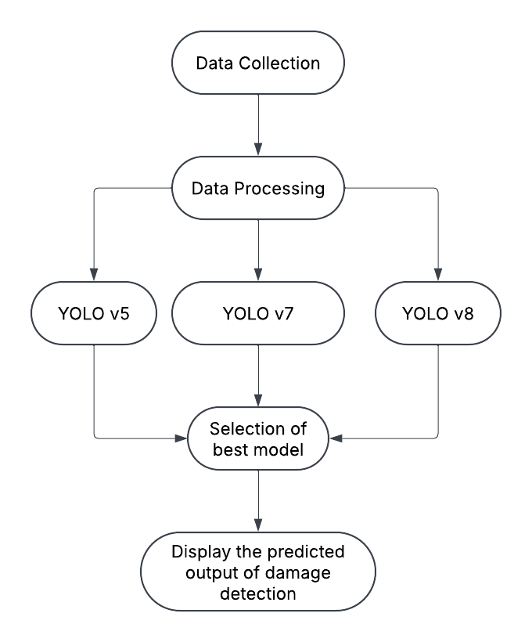
ARCHITECTURE

Slide 11
MODULES
MODULE IMPLEMENTATION: Data collection module To capture high-resolution images of roads from various angles, enabling automated analysis. Data preprocessing module Model building module Apply algorithms and predict module View of predictions(GUI) | MODULES USED Pandas Unmanned Aerial Vehicles (UAVs) Tensorflow Keras Sklearn TkInter

Slide 12
METHODOLOGIES
Data Collection: Use UAVs (Unmanned Aerial Vehicles) to capture high-resolution images of roads.
Preprocessing: Enhance image quality, remove noise, and segment road areas for better analysis.
Deep Learning Model Selection: Choose and train a suitable deep learning architecture like CNNs (Convolutional Neural Networks) for damage detection.
Feature Extraction: Identify and extract relevant features such as cracks, potholes, or surface deterioration from the images.
Classification: Use the trained model to classify road damage types based on the extracted features.
Validation and Testing: Evaluate the model's accuracy and performance on a diverse dataset.
Integration: Develop a user interface or system for displaying detection results and integrating real-time UAV data.

Slide 13
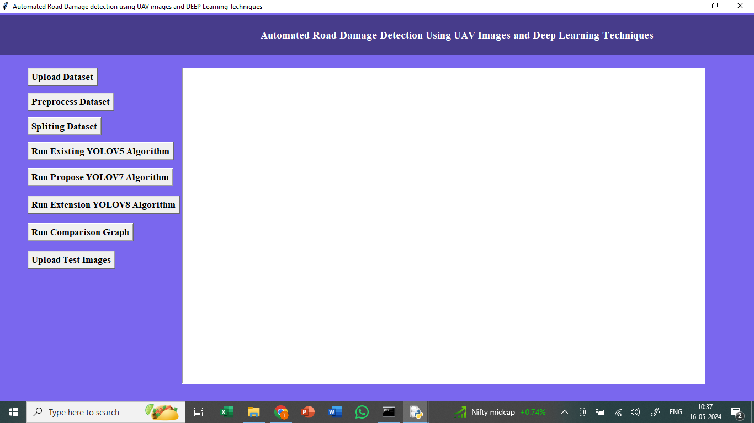
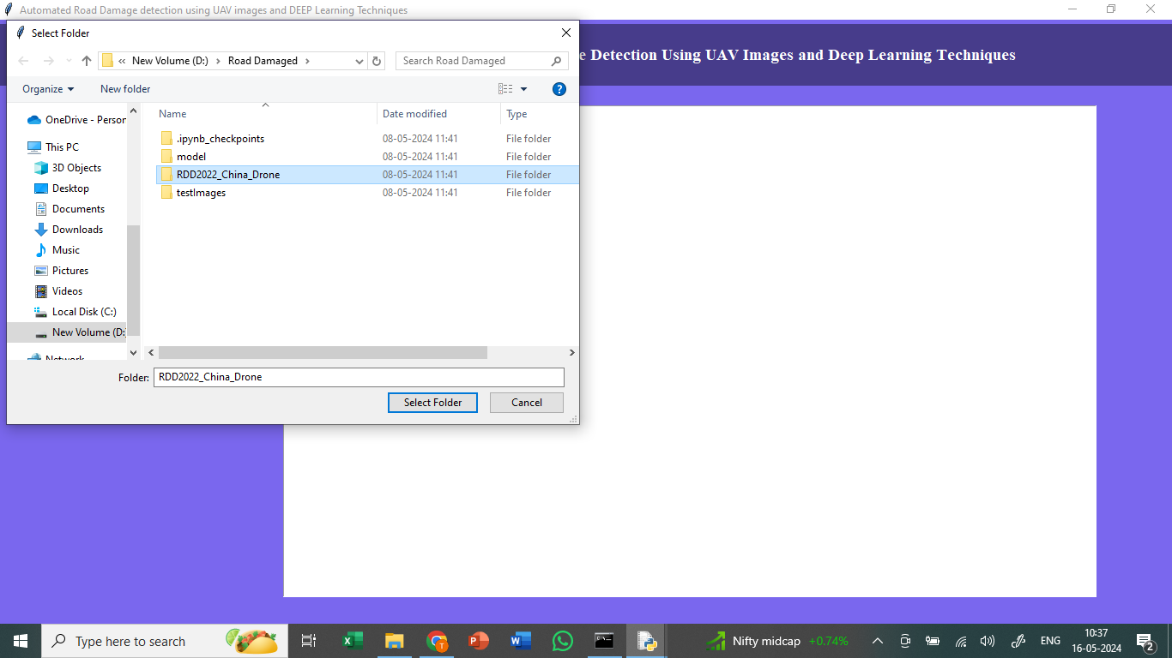
SAMPLE OUTPUT
In above screen connecting and loading all dataset images and after executing above block will get below output

Slide 14
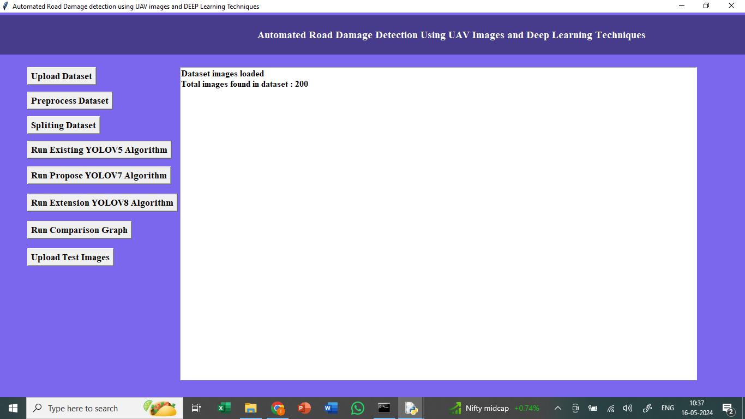
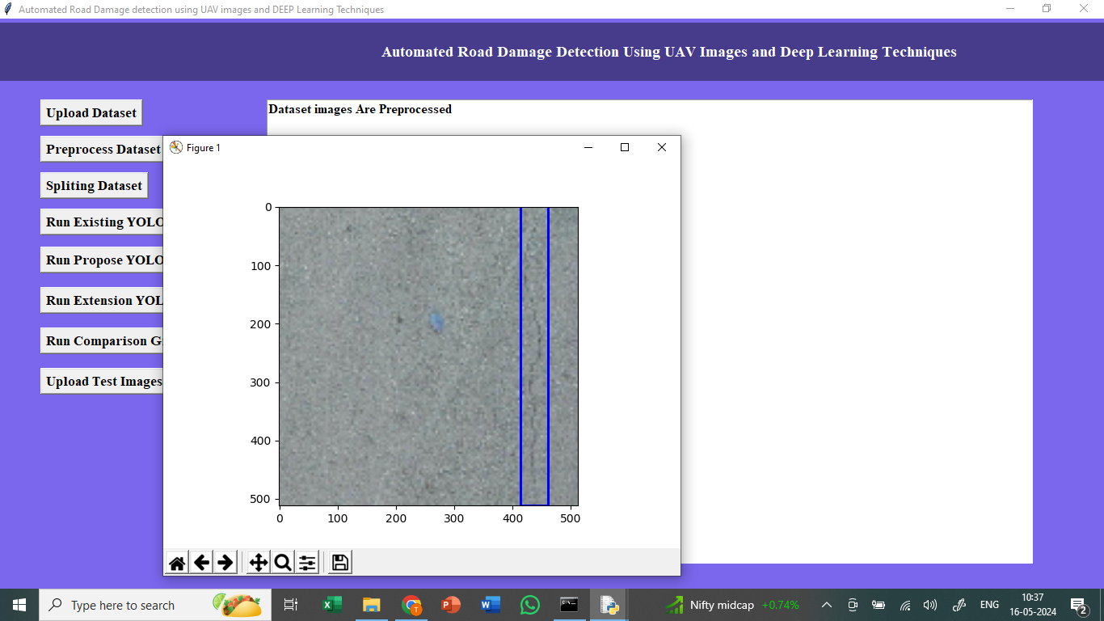
SAMPLE OUTPUT
In above screen in text printing number of dataset images loaded
In above screen displaying one sample processed image with blue colour bounding box surrounded across damage road

Slide 15

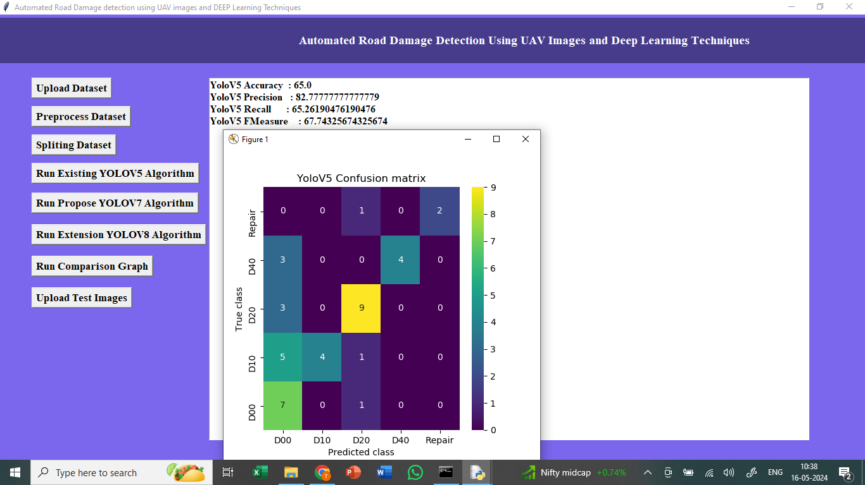
SAMPLE OUTPUT
In above screen shuffling, normalizing and splitting dataset into train and test
In above screen training Yolov5 model and YoloV5 got 65% accuracy and other metrics also displaying and in above confusion matrix x-axis represents Predicted Labels and y-axis represents True Labels and all boxes in diagonal represents correct prediction count and remaining boxes represents incorrect prediction count

Slide 16
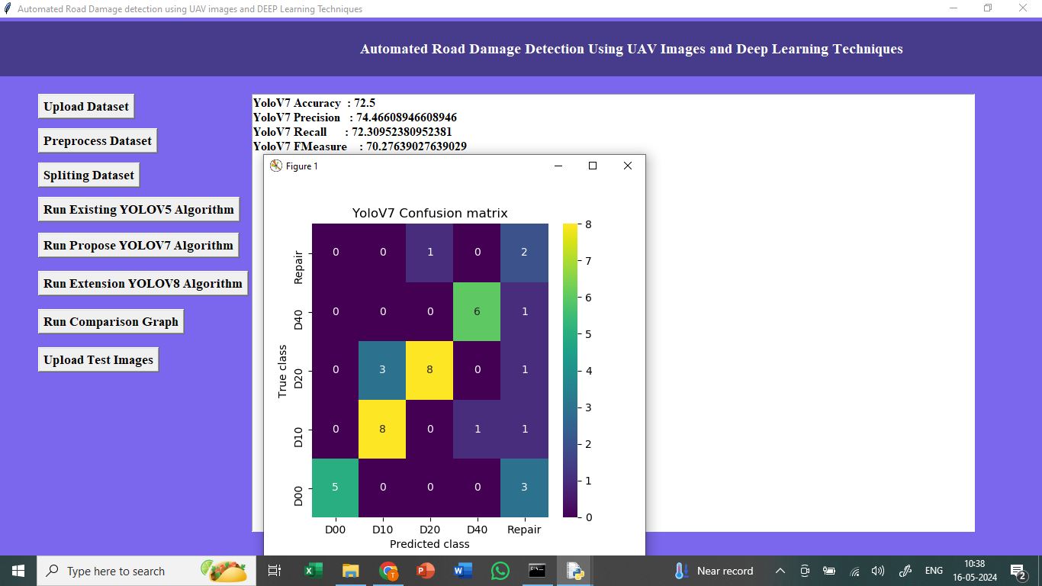
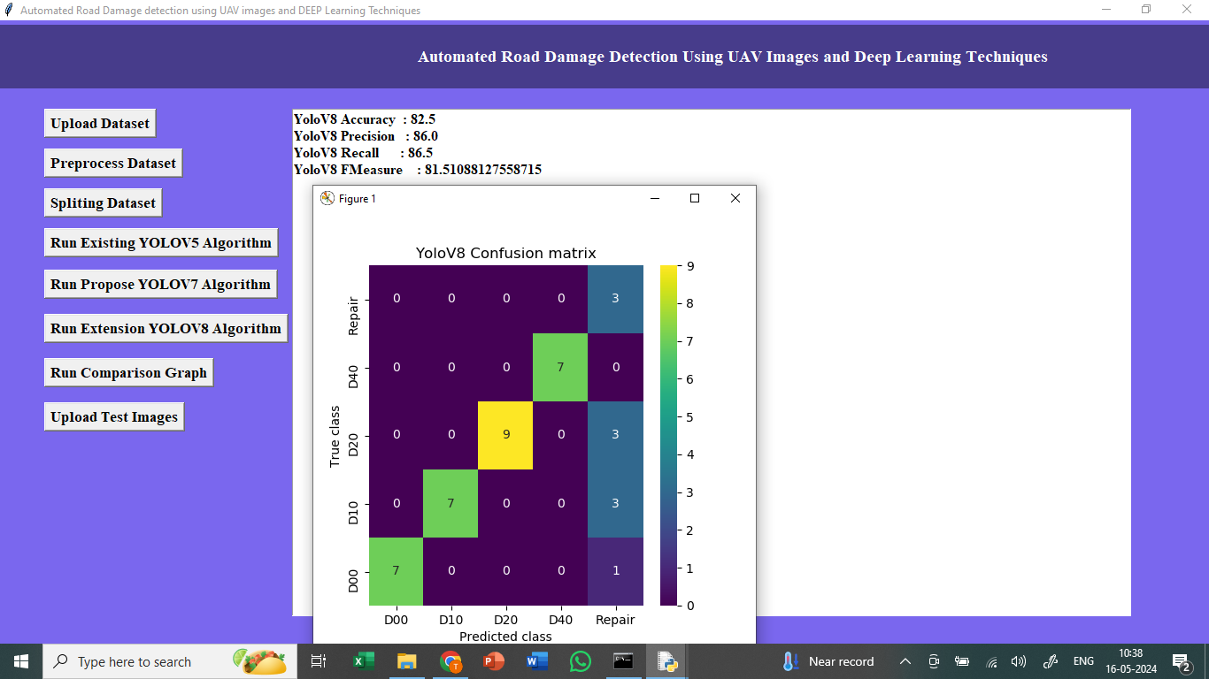
SAMPLE OUTPUT
In above screen training Yolov7 and Yolov7 got 82% accuracy and can see other metrics and confusion matrix graph
In above screen training Yolov8 from Ultralytics package and after executing above block YoloV8 got 85% accuracy which is higher than any other algorithm

Slide 17
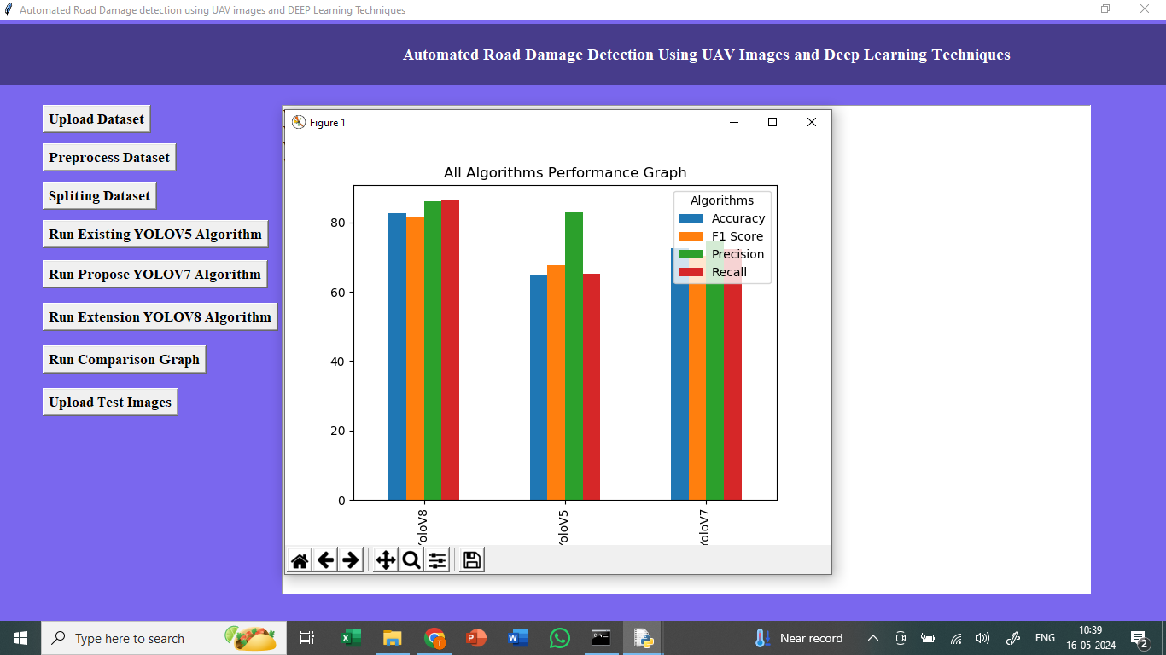
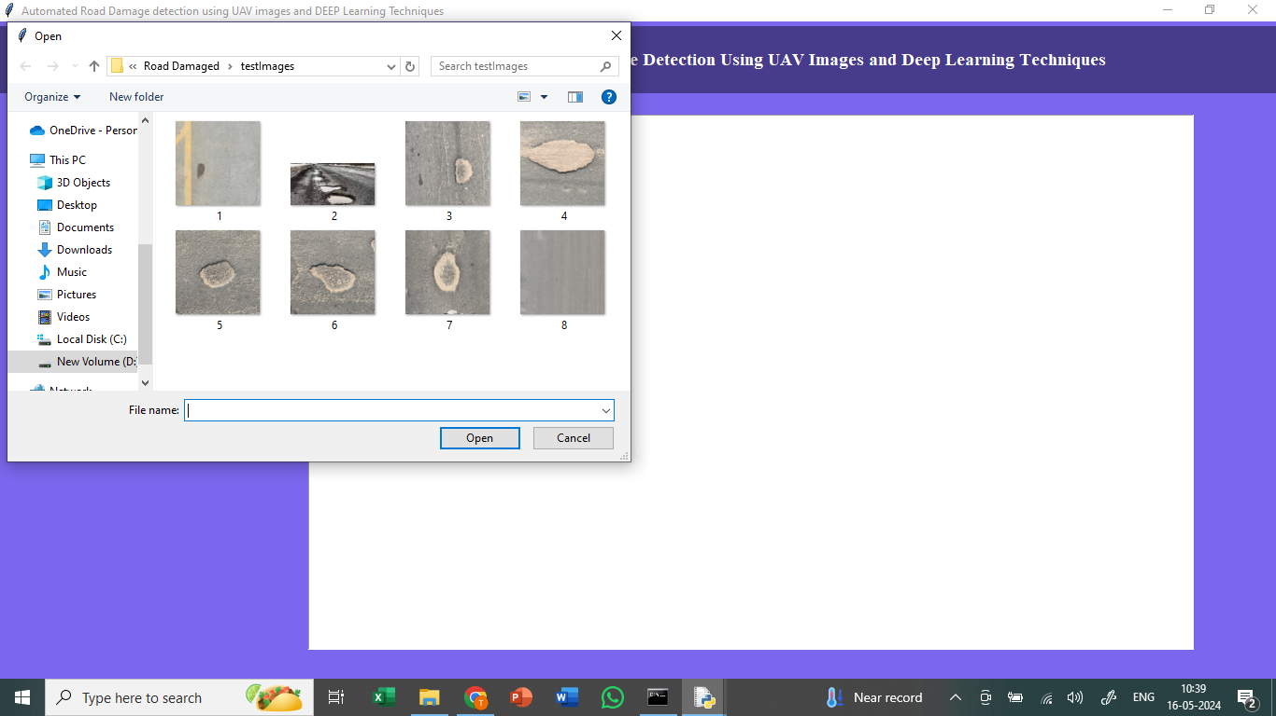
SAMPLE OUTPUT
In above graph displaying comparison between all algorithms where x-axis represents algorithm names and y-axis represents accuracy and other metrics in different colour bars
In above screen uploading road damaged image from test images folder

Slide 18
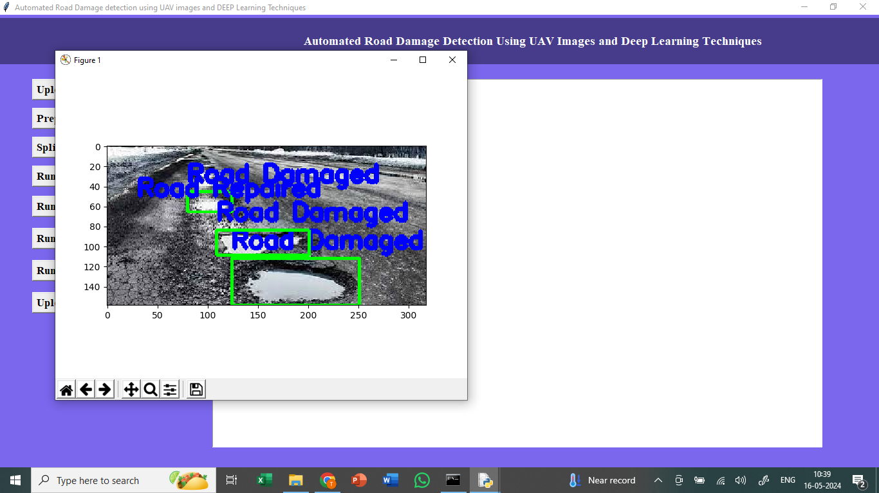
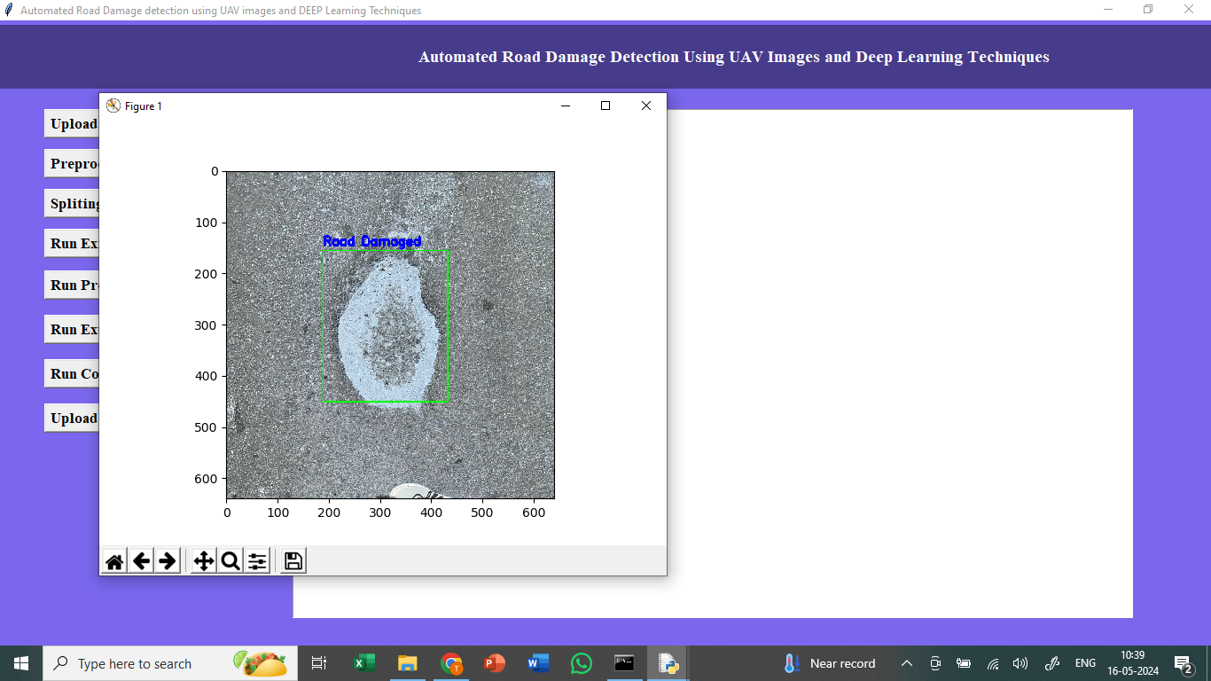
SAMPLE OUTPUT
In above screen with bounding boxes damage road detected from given test input images
In above screen we can see other tested images

Slide 19
CONCLUSION & FUTURE ENHANCEMENT
This project aims to develop an advanced system for detecting road damage using UAV images and YOLO architectures. By leveraging the latest YOLO versions, including YOLOv5, YOLOv7, and YOLOv8, alongside a tailored UAV image database and the RDD2022 dataset, the system enhances damage identification accuracy. It addresses class imbalances for specific damage types such as potholes and alligator cracks, making detection more robust. Future enhancements will explore multispectral images, LIDAR sensors, and fixed-wing UAVs to improve efficiency and real-time performance. This project provides practical solutions for effective infrastructure maintenance.
FUTURE ENHANCEMENT:
Use multispectral images and LIDAR sensors for better damage detection.
Explore fixed-wing UAVs for improved coverage and efficiency.
Develop models that handle larger and more diverse datasets.
Implement embedded computing for real-time processing and integration.
Enhance detection capabilities for complex road damage types.

Slide 20
REFERENCES
[1] V. J. Hodge, R. Hawkins, and R. Alexander, ‘‘Deep reinforcement learning for drone navigation using sensor data,’’ Neural Comput. Appl., vol. 33, no. 6, pp. 2015–2033, Jun. 2020, doi: 10.1007/s00521-020-05097-x.
[2] D. Gallacher, ‘‘Drones to manage the urban environment: Risks, rewards, alternatives,’’ J. Unmanned Vehicle Syst., vol. 4, no. 2, pp. 115–124, Jun. 2016 .
[3] D. Jeong, ‘‘Road damage detection using YOLO with smartphone images,’’ in Proc. IEEE Int. Conf. Big Data (Big Data), Dec. 2020, pp. 5559–5562, doi: 10.1109/BIGDATA50022.2020.9377847.
[4] Y. Bhatia, R. Rai, V. Gupta, N. Aggarwal, and A. Akula, ‘‘Convolutional neural networks based potholes detection using thermal imaging,’’ J. King Saud Univ.-Comput. Inf. Sci., vol. 34, no. 3, pp. 578–588, Mar. 2022, doi: 10.1016/j.jksuci.2019.02.004.
[5] D. Arya, H. Maeda, S. K. Ghosh, D. Toshniwal, and Y. Sekimoto, ‘‘RDD2022: A multi-national image dataset for automatic road damage detection,’’ 2022, arXiv:2209.08538.

